Slide 1

Heart Disease Prediction A Machine Learning Approach
The aim of this presentation to identify the risk of heart disease based on key health indicators like age, cholesterol levels, blood pressure, glucose, BMI, and lifestyle factors. By analyzing patterns in medical data, this model aims to assist in early detection and preventive care, ultimately helping in reducing heart disease risks. 🚑🔬
Presented By – Ashish Singh

Slide 2

Problem Statement
Why This Project?
- Heart disease is a leading cause of death.
- Early detection can save lives.
- Build a prediction model.

Slide 3
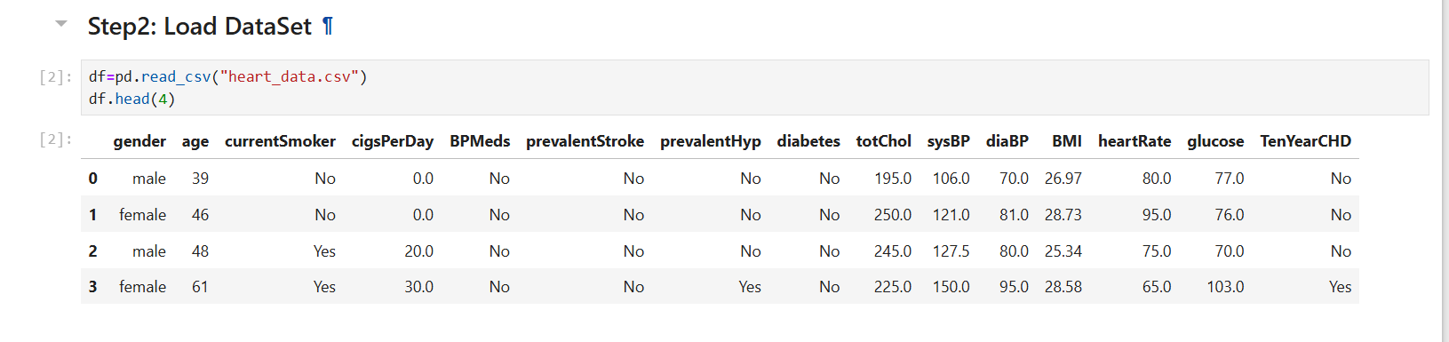
Dataset Overview
Dataset Name: Heart Disease Dataset
Total Rows: 4240 , Total Columns: 15
Key features: Age, Cholesterol, Blood Pressure, Glucose, BMI, etc.
Target Variable: TenYearCHD
Data Types: Categorical & Numerical

Slide 4
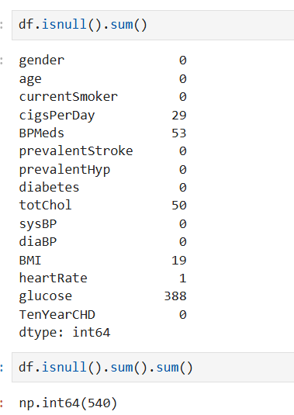
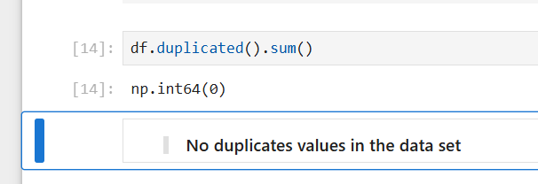
Exploratory Data Analysis (EDA)
There are total 6 columns in which the values are missing .
Missing values → Total 540 missing values found in the data set .
Duplicates Records →There is no duplicate values found in the data set .

Slide 5
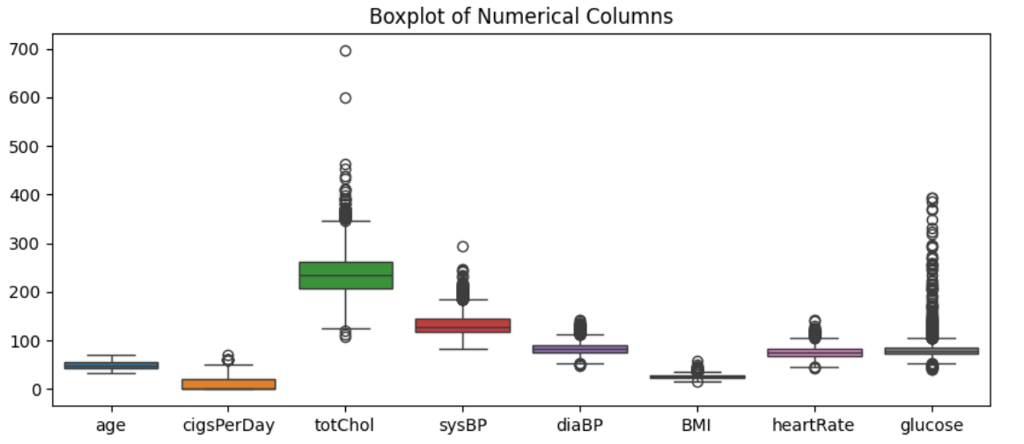
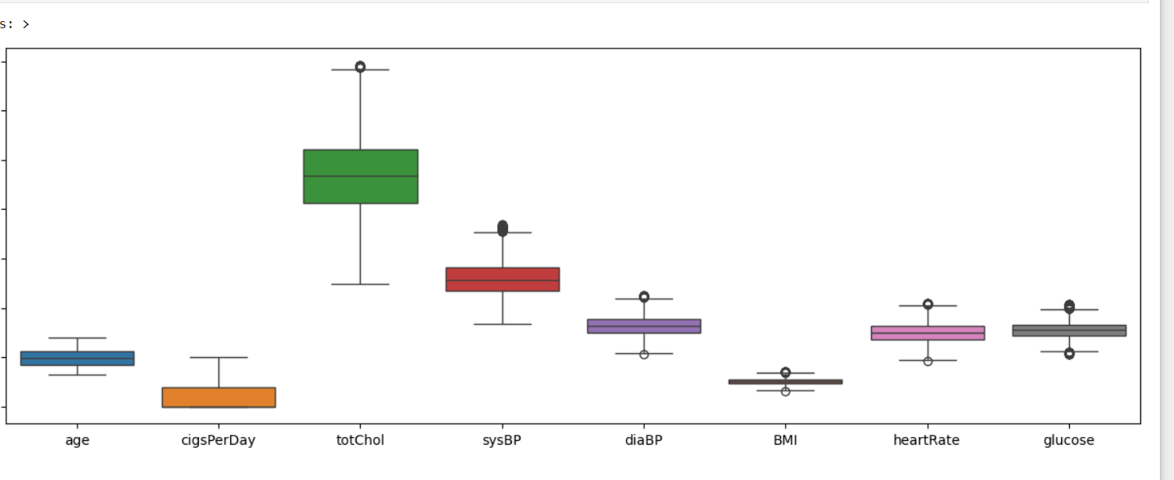
Exploratory Data Analysis (EDA)
Checked for outliers :Outliers detect with the help of boxplot for numerical columns.
Handle using IQR Method
Calculate IQR: IQR = Q3 - Q1 (Difference between 75th & 25th percentile)
Determine Boundaries:
Lower Bound = Q1 - 1.5 * IQR
Upper Bound = Q3 + 1.5 * IQR
Remove Values Outside These range

Slide 6
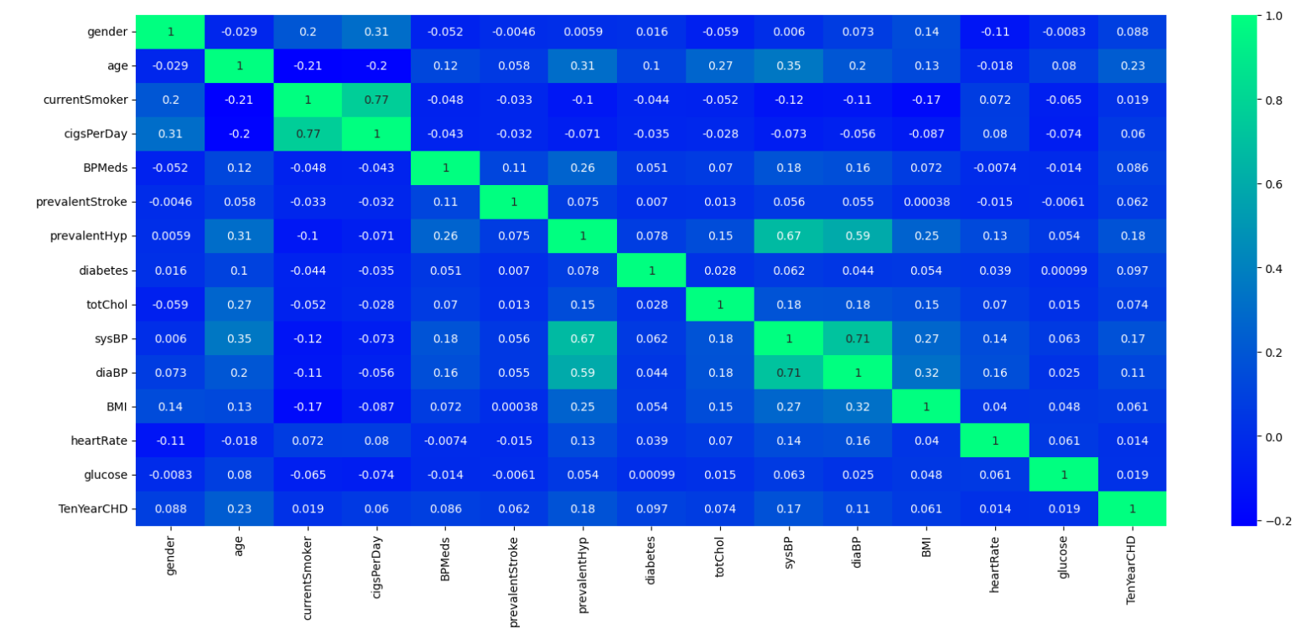
Feature Engineering & Selection
Step 1→ Label Encoding
Apply label Encoding to categorical column
gender , currentSmoker , BPMeds , prevalentStroke , prevalentHyp , diabetes , ‘TenYearCHD'
Step 2→Checking The Correlation
Dropped irrelevant or highly correlated feature
cigsPerDay , diaBP , prevalentHyp
Selected best predictors using correlation analysis.

Slide 7

Data Preprocessing
Step 1→ Train Test Split
Apply Train Test Split
Train-Test Split (e.g., 75%-25%)
75% Training Set (X_train, y_train)
25% Testing split Set (X_test , y_test)
Ensured randomness with random_state=42
Step 2→ Standardization
Apply Feature Scaling (Standardization)
Standardization using StandardScaler()
Standard Scaling (Standardization) is used to normalize features in a dataset so that they have a mean of 0 and a standard deviation of 1

Slide 8
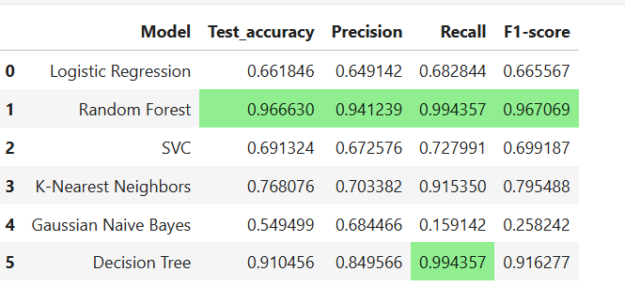
Model Selection And Training
Logistic Regression
Random Forest
K-Nearest Neighbor
Gaussian Naïve Bayes
SVC
Decision Tree
0.966630
0.910456
0.549499
0.691324
0.661846
0.768076
Save the model by using
Model.pkl

Slide 9
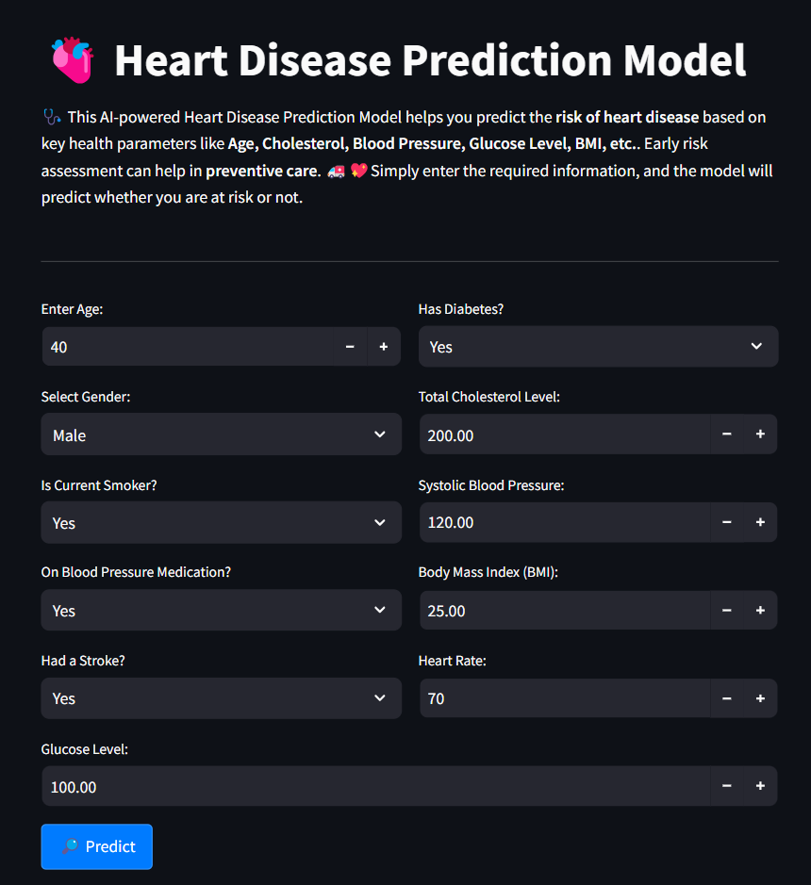
Deployment of the Model
Model deployed using Streamlit
User-friendly interface
Easy-to-use web interface
Frontend: Streamlit Backend: Python
Libraries: Pandas, NumPy, Scikit-learn,
Streamlit, Pickle
Potential applications in hospitals and clinics.
Model predicts risk level based on inputs.
Prediction Output:
✅ Not at Risk - ⚠️ At Risk

Slide 10

Real-World Applications
Use cases in healthcare
Benefits for doctors and patients
Alerts for lifestyle adjustments.
Supports medical research on heart disease risks.
Early detection for preventive care.
Personalized Treatment Plans for better patient care
Development & Trials for better medicines.
Hospital Resource Management for efficient care.

Slide 11


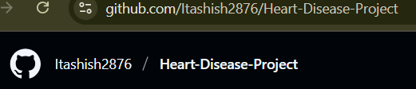
FOR YOUR TIME AND ATTENTION
I HOPE YOU FIND THIS PRESENTATION INSIGHTFUL
“Check out my work on GitHub!”

